Slide 1

Working with 2d Graphics
Lecturer : Tanaboon Tongbuasirilai
Course : ICCS404
Week 2 : 2D Graphics

Slide 2
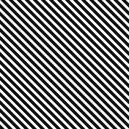
Topics
Pixels, coordinates and colors
Shape
Transformation

Slide 3
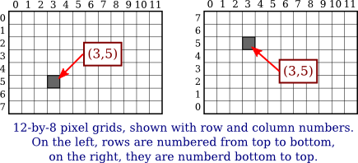
Pixels
A pixel, short for "picture element", is the fundamental building block of digital images and displays. Imagine the tiny squares that make up a mosaic - each individual square is like a pixel. These pixels come together to form the images you see on screens like computer monitors, smartphones, and TVs.
Notes:
Tiny elements to form images on displays.
The location depends on its definition or reference point. (3,5) in both figures.

Slide 4

More about pixels.
Mathematically, a pixel contains an infinite number of points.
Pixels are an approximation. (A real value to an integer)
The goal of computer graphics is to create and manipulate images.
Characteristics of pixels
A pixel has a color.
The number of pixels defines the image resolution.
An image with high pixel density, pixels per inch (PPI), brings high details of digital contents. Higher PPI results in sharper images because more pixels are packed into the same physical space.
Notes:
Talking about real-world coordinates = real values → pixel integer coordinates
Grid of pixels and curves = best visual representations
.
Ideal image descriptions use real-number coordinates, while pixel locations are restricted to integers (row and column numbers).
This mapping can cause aliasing as multiple real-number coordinates might collapse onto the same integer pixel location.

Slide 5
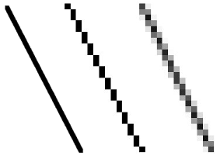

Antialiasing
Combating aliasing - Antialiasing is a collection of techniques designed to reduce the visual artifacts caused by aliasing, such as jagged edges on diagonal lines.
Approximate Calculations - Precise area calculations for antialiasing within each pixel are computationally expensive. Practical implementations use efficient approximation methods.
Integer coordinates and pixel boundaries - Integer coordinates are often seen as representing the lines between pixels, not the pixels themselves. This adds another layer of complexity when translating real-number coordinates to actual displayed pixels.
Line thickness vs. pixel size - Drawing lines with a thickness greater than one pixel width creates challenges. The top line example shows how a "one-pixel" line gets drawn half in two rows due to antialiasing, resulting in a gray appearance.
Different Rendering Systems - Different graphics systems may render the same lines differently, as seen with the example of the line drawn from (100.5,100.5) to (120.5,100.5) that lies exactly along one line of pixels.

Slide 6
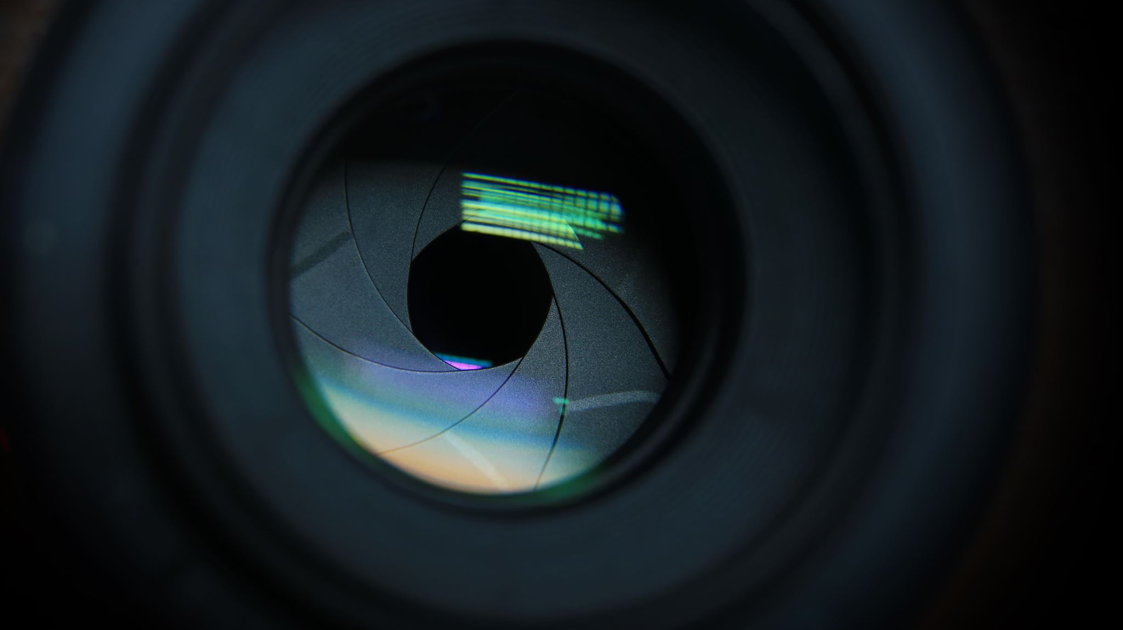
Demo – Pixel Magnifier
https://math.hws.edu/graphicsbook/c2/s1.html

Slide 7
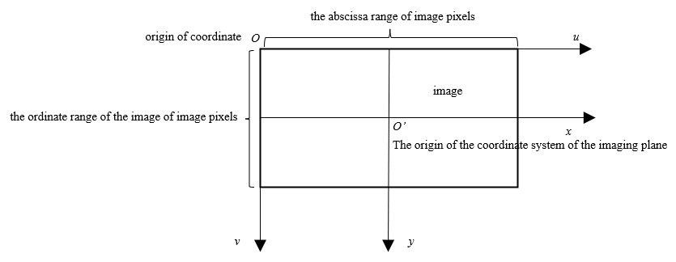
Coordinate systems
The coordinate system is established by specifying the horizontal and vertical bounds of the rectangle where the graphics are drawn (left, right, top, bottom).
The coordinate system used for drawing graphics should be chosen based on the specific application. This allows for a natural representation of the elements being drawn.
The coordinate system can have its own unit of measure (like feet in a floor plan) that may not directly correspond to pixels on the display. One unit in the system can map to many pixels.
Coordinates are generally real numbers, not integers, allowing for more precise placement of points within the image. Ideally, graphics primitives are specified using real-number coordinates for better precision, rather than restricting them to integer pixel locations.
Notes:
Coordinate system = bound by left right top bottom = rectangle.
Specific application has its own coordinate system → best to define its own system

Slide 8
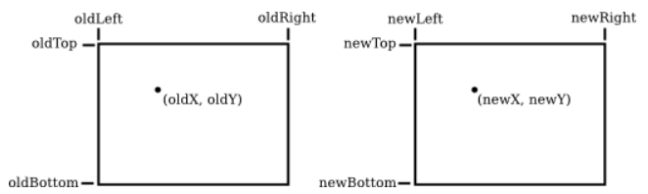
Coordinate transformation
newX = newLeft + ((oldX - oldLeft) / (oldRight - oldLeft)) * (newRight - newLeft))
newY = newTop + ((oldY - oldTop) / (oldBottom - oldTop)) * (newBottom - newTop)
Example
To transform some real-number coordinate system with limits left, right, top, and bottom into pixel coordinates that range from 0 at left to 800 at the right and from 0 at the top 600 at the bottom.
newLeft = newTop = 0
newX = ((oldX - left) / (right - left)) * 800
newY = ((oldY - top) / (bottom - top)) * 600
Notes:
Talking about mapping between , for example, two screen resolution.
2d coordinate transformation equations

Slide 9
Aspect ratio
Common Aspect Ratios
4:3: Traditional television and computer monitors.
16:9: Modern widescreen TVs, computer monitors, and most smartphones.
1.85:1 and 2.39:1: Common in film and cinema for a wider viewing experience.
When scaling an image or graphic to fit a different aspect ratio, both the width and height must be adjusted proportionally to maintain the aspect ratio. For example, scaling a 4:3 image to fit a 16:9 screen without preserving the aspect ratio will distort the image.
For example, an aspect ratio of 2:1 means that a rectangle is twice as wide as it is tall, and an aspect ratio of 4:3 means that the width is 4/3 times the height.
If the horizontal and vertical limits for the coordinate system are left, right, bottom, and top, as above, then the aspect ratio is the absolute value of
(right - left) / (top - bottom)
The aspect ratio is the ratio of the width to the height of an image or display screen. It is typically expressed as two numbers separated by a colon, such as 16:9 or 4:3. Aspect ratio is a crucial concept in various fields like photography, television, computer graphics, and film, as it determines the shape and format of the visual content.

Slide 10
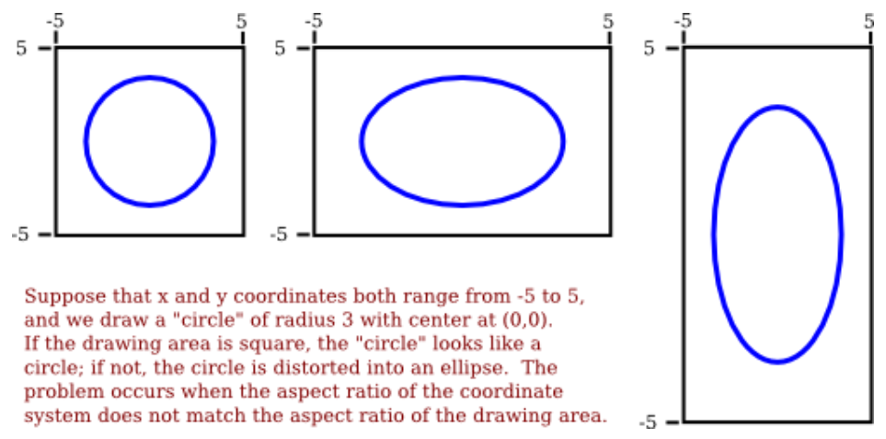
A circle of radius 3 on different aspect ratios.
Notes:
Aspect ratio may cause some distortion.

Slide 11
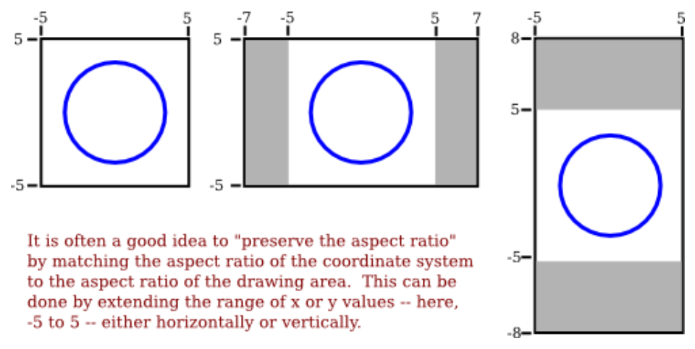
A circle of radius 3 but on the same aspect ratios
Notes:
Preserving aspect ratio of the drawing area

Slide 12
Color
Colors on screens are created by combining red, green, and blue light, with each color specified by three numbers representing the intensity of each component.
Intensities range from 0 (minimum) to 1 (maximum), forming the RGB color model.
The range of colors a device can produce is called its color gamut, which varies between screens and printers, affecting color accuracy and consistency.
Printers use the CMYK color model (cyan, magenta, yellow, black), which differs from the RGB model used by screens.
RGB colors are often represented with 8 bits per component (24-bit color), but other bit depths are used depending on application needs.
More bits per component (16 or 32 bits) can be used to improve accuracy in color computations, while fewer bits (16-bit color) save memory and were common when memory was costlier.
Human eyes have three types of cone cells sensitive to red, green, and blue light, but they respond to a range of wavelengths, not just pure colors.
Perceived colors are determined by the stimulation levels of these cone cells.
While the RGB system (red, green, blue) defines colors on screens, it can't replicate the full spectrum our eyes perceive.
Notes:
S M L cone cells → perceived light in a range
R G B → small ranges of color spectrum
Color variations = mixing R G B
Intensity range = (0, 1)
Color gamut = a range of colors affects accuracy and consistency

Slide 13
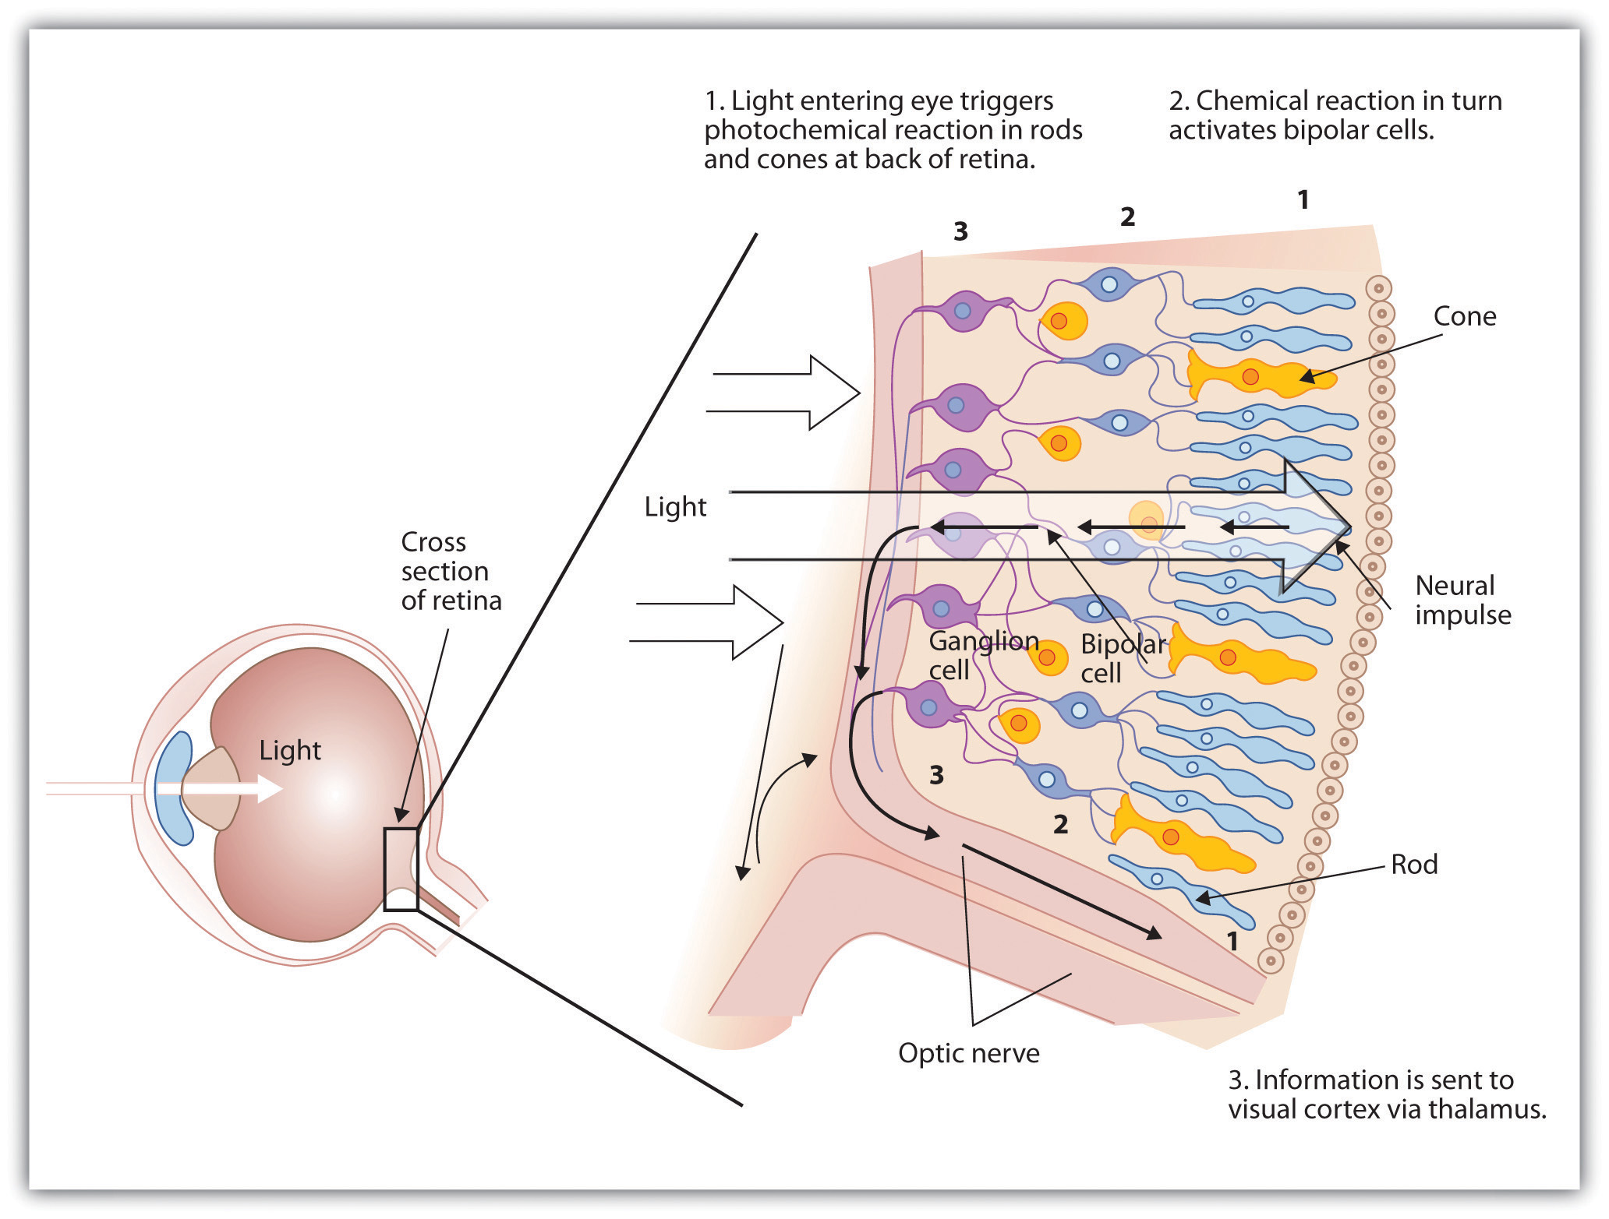
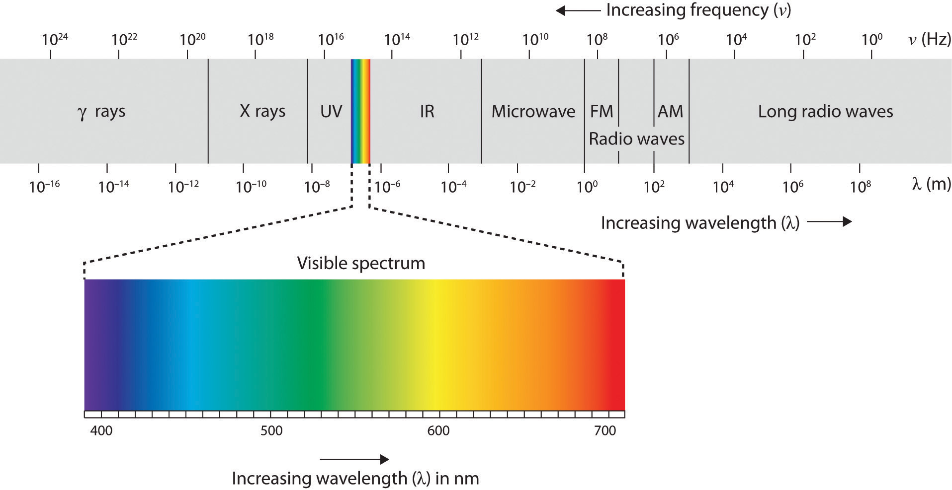
Human Visual System (HVS)
https://saylordotorg.github.io/text_introduction-to-psychology/s08-02-seeing.html

Slide 14
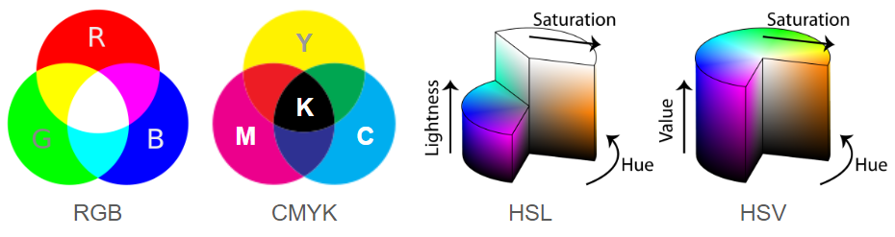
Color models
RGB (Red, Green, Blue) - The most common color model for displaying colors on electronic devices like screens. It combines red, green, and blue light in various intensities to create different colors.
CMYK (Cyan, Magenta, Yellow, Key Black) - Primarily used in printing. CMYK inks subtract light to create colors. Combining cyan, magenta, and yellow inks creates black, but in practice, a separate black ink (Key Black) is used for better quality.
HSV (Hue, Saturation, Value) and HSL (Hue, Saturation, Lightness) - These are variations on a theme. They represent color in a more intuitive way than RGB. Hue refers to the actual color itself (red, green, blue, etc.), Saturation controls the color intensity (pure color vs. grayish), and Value/Lightness controls the brightness. The slight difference lies in how they handle pure colors – HSV assigns maximum value for pure colors, while HSL assigns mid-point lightness.
YCbCr (Luma, Chroma Blue, Chroma Red) - This model is used for video and image compression. It separates the brightness information (Y - Luma) from the color information (Cb - Chroma Blue and Cr - Chroma Red). This allows for more efficient storage and transmission of video data.
https://wikidocs.net/231484

Slide 15
Demo – Color Model
https://math.hws.edu/graphicsbook/c2/s1.html

Slide 16
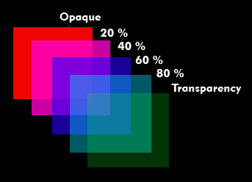
Transparency
Alpha ranges from 0 (completely transparent) to 1 (fully opaque). Values in between create translucent colors.
A 32-bit integer can represent an RGBA color. The order of components within these 32 bits can vary (often Alpha-Red-Green-Blue, but other arrangements exist).
Understanding alpha blending helps visualize how transparent objects interact with the background in digital art and design.
Alpha blending is the most common use of the alpha component, useful for creating visual effects like shadows, translucency, and smooth edges in computer graphics.
Adding Transparency - A fourth component called "alpha" is introduced in color models like RGBA and HSLA. This doesn't represent color itself, but controls transparency.
It is called ‘alpha blending’.
https://www.itwissen.info/lex-images/Beispiel-fuer-Alpha-Blending-mit-verschiedenen-Transparenzstufen_en.png

Slide 17
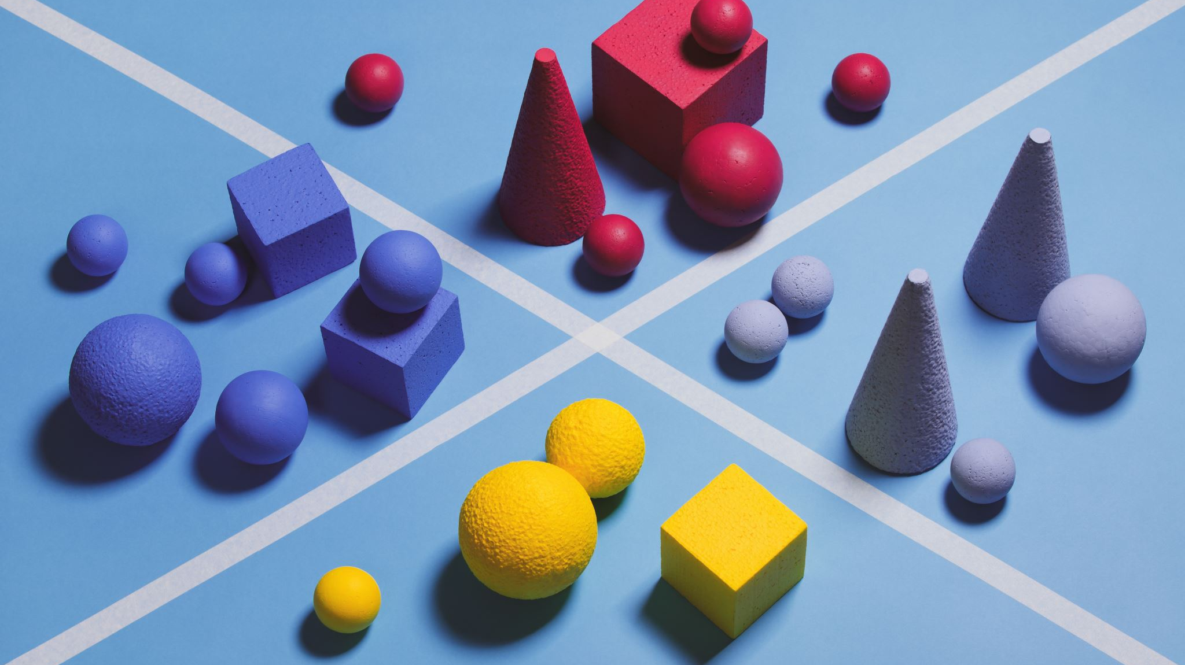
Shapes

Slide 18
Basic shapes
Line
Rectangle
Circle
Oval

Slide 19

Line drawing
A simple one-pixel-wide line without antialiasing is the most basic shape, drawn by coloring pixels along the geometric line segment.
Computer graphics deal with lines beyond a simple one-pixel width. Concepts like antialiasing and line width add complexity.
Lines have properties like caps (rounded or square ends) and joins (how lines connect at corners) that affect their appearance.
Advanced graphics systems allow lines to be patterns of dashes and dots, adding visual interest.
An efficient algorithm, Bresenham's Algorithm, for line drawing, deciding which pixels to color, is one of the earliest computer graphics algorithms worth studying for understanding low-level graphics operations.

Slide 20
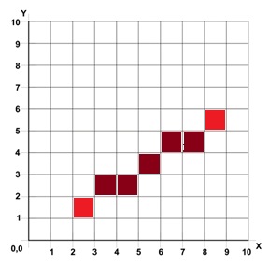
Bresenham’s Line algorithm
Input : (x1, y1) and (x2, y2) → 2 ending points of the line.
Compute
dx = |x2 – x1|
dy = |y2 – y1|
d = 2dy – dx
Iterate until x = x2
If d > 0, then move y+1 and d = d-(2dx)
move x+1 and d = d+2dy
Note that this pseudocode is handling only a case. For the general cases, please check the reference link below.
https://en.wikipedia.org/wiki/Bresenham%27s_line_algorithm

Slide 21
Rectangles
Specifying a Rectangle
Diagonal Points - Specified by endpoints (x1, y1) and (x2, y2) of one diagonal.
Dimensions and Base Point - Defined by width, height, and a single base point (x, y). Width and height must be positive for a valid rectangle.
The base point (x, y) changes based on coordinate system orientation
Y Increases Top to Bottom - (x, y) is the upper left corner.
Y Increases Bottom to Top - (x, y) is the lower left corner.

Slide 22
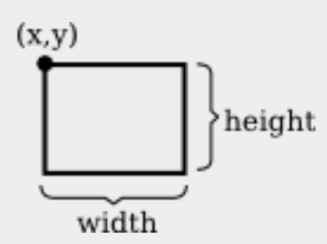
An algorithm for drawing a rectangle
DrawRectangle from points (x1,y1) and (x2,y2)
x = min( x1, x2 )
y = min( y1, y2 )
width = abs( x1 - x2 )
height = abs( y1 - y2 )
DrawRectangle( x, y, width, height )

Slide 23
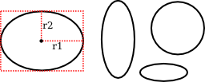
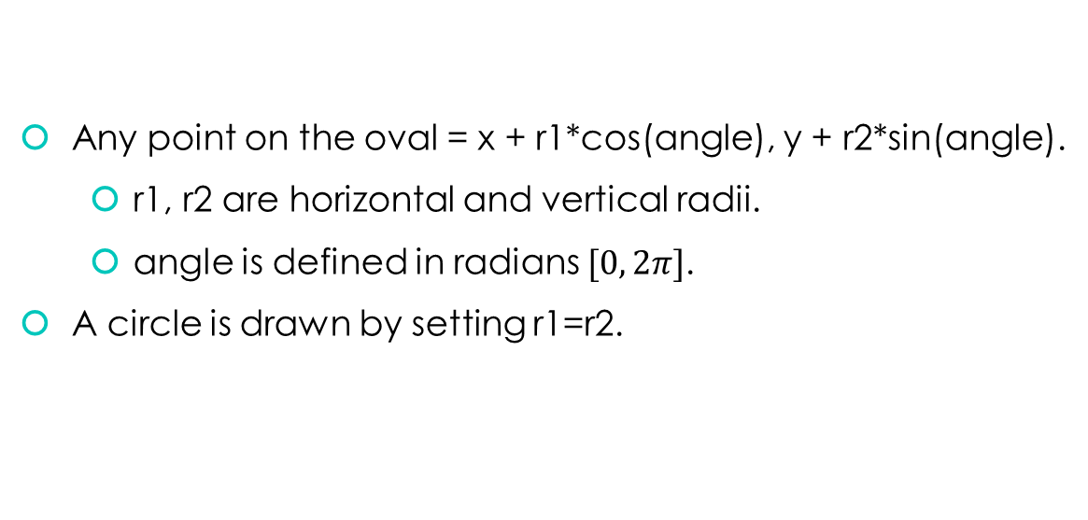
An oval shape
Any point on the oval = x + r1*cos(angle), y + r2*sin(angle).
r1, r2 are horizontal and vertical radii.
angle is defined in radians $[0, 2π]$.
A circle is drawn by setting r1=r2.

Slide 24
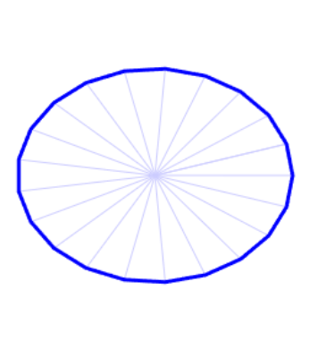
An algorithm for drawing an oval
Draw Oval with center (x,y), horizontal radius r1, and vertical radius r2:
for i = 0 to numberOfLines:
angle1 = i * (2*pi/numberOfLines)
angle2 = (i+1) * (2*pi/numberOfLines)
a1 = x + r1*cos(angle1)
b1 = y + r2*sin(angle1)
a2 = x + r1*cos(angle2)
b2 = y + r2*sin(angle2)
Draw Line from (a1,b1) to (a2,b2)
https://math.hws.edu/graphicsbook/c2/s2.html

Slide 25
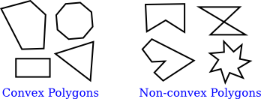
Polygons
A polygon is a closed shape consisting of a sequence of line segments. Each line segment is joined to the next at its endpoint, and the last line segment connects back to the first.
A convex polygon has the property that whenever two points are inside or on the polygon, then the entire line segment between those points is also inside or on the polygon.
Polygons are usually required to be "planar," meaning that all the vertices lie in the same plane.
Squares and equilateral triangles are examples of regular polygons.

Slide 26
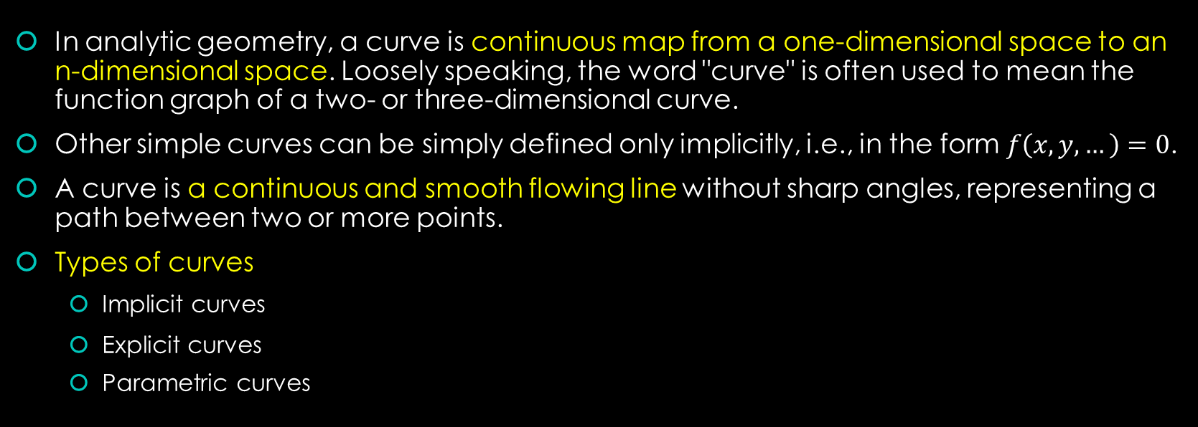
Curves
In analytic geometry, a curve is continuous map from a one-dimensional space to an n-dimensional space. Loosely speaking, the word "curve" is often used to mean the function graph of a two- or three-dimensional curve.
Other simple curves can be simply defined only implicitly, i.e., in the form $f\left(x, y,…\right)=0$.
A curve is a continuous and smooth flowing line without sharp angles, representing a path between two or more points.
Types of curves
Implicit curves
Explicit curves
Parametric curves

Slide 27
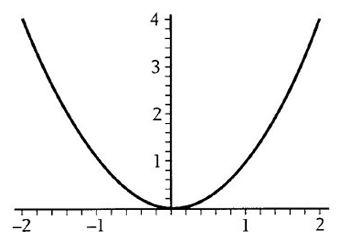
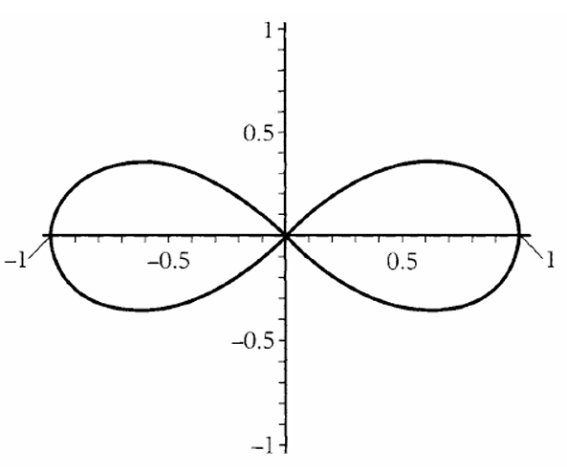
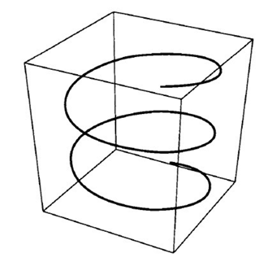
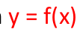
Curve representations
Explicit
Implicit
Parametric
https://www.tecgraf.puc-rio.br/ftp_pub/lfm/L2A_CurveRepresentations.pdf

Slide 28
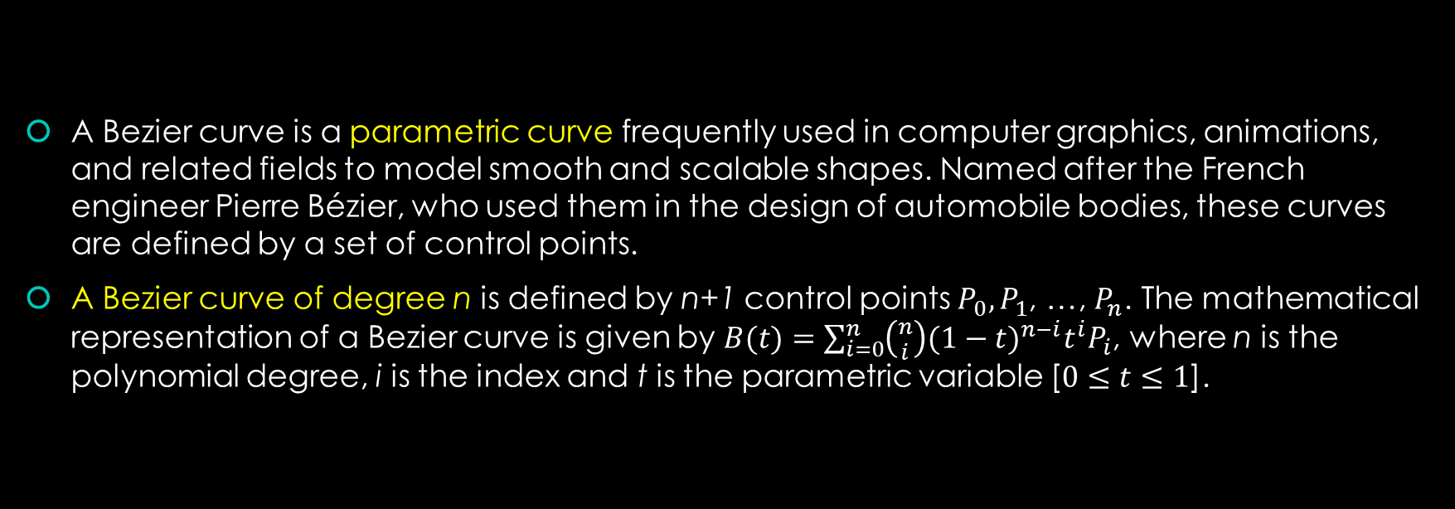
Bezier curve
A Bezier curve is a parametric curve frequently used in computer graphics, animations, and related fields to model smooth and scalable shapes. Named after the French engineer Pierre Bézier, who used them in the design of automobile bodies, these curves are defined by a set of control points.
A Bezier curve of degree n is defined by n+1 control points $P_{0},P_{1}$, …, $P_{n}$. The mathematical representation of a Bezier curve is given by $B(t)=\sum_{i=0}^{n}{\left({n \atop i}\right){(1−t)}^{n−i}t^{i}P_{i}}$, where n is the polynomial degree, i is the index and t is the parametric variable [$0≤t≤1$].
https://www.tutorialspoint.com/computer_graphics/computer_graphics_curves.htm
Notes:
N choose I = binomial coefficient

Slide 29
Properties of Bezier curve
Geometry invariance property - how the shape of the curve remains the same even when the control points are subjected to certain transformations, as long as those transformations are affine.
End points geometric property - The first and last control points (P₀ and Pn) always coincide with the starting and ending points of the curve, respectively.
Convex hull property - The entire Bézier curve lies entirely within the convex hull of its control points. Imagine the control points as nails holding a rubber band taut. The curve stays within the shape formed by the rubber band.
Symmetry - If you create a Bézier curve using these reversed control points, the resulting curve will have the same shape as the original curve. However, the direction or "flow" of the curve will be reversed.
Variation diminishing property - The curve never oscillates (goes above and below a line) more often than the defining polygon formed by the control points.
https://web.mit.edu/hyperbook/Patrikalakis-Maekawa-Cho/node12.html
Notes:
Geometry Invariance Property:
This property describes how the shape of a Bézier curve remains the same even when its control points undergo certain transformations. These transformations must be affine, meaning they preserve lines and parallelism. Common examples include:
Translation: Shifting all control points in a specific direction (left, right, up, down).
Rotation: Rotating all control points around a fixed point.
Scaling: Uniformly shrinking or expanding all control points.
End Points Geometric Property:
This property states that the first and last control points of a Bézier curve (P₀ and Pn) always coincide with the starting and ending points of the curve itself.
In simpler terms, the Bézier curve always begins and ends exactly at the positions defined by the first and last control points, respectively. This provides a clear connection between the control points and the resulting curve.
Convex Hull Property:
This property defines the region where the Bézier curve can reside. It states that the entire curve lies entirely within the convex hull of its control points.
Imagine the control points as nails holding a rubber band taut. The convex hull is the shape formed by the rubber band. The Bézier curve will never stray outside this area, ensuring a smooth path that reflects the positions of the control points.
Symmetry:
This property deals with the effect of reversing the order of the control points. If you take the original set of control points (P₀ through Pn) and rearrange them in reverse order (Pn through P₀), the resulting Bézier curve will have the same shape as the original curve.
However, the direction or "flow" of the curve will be reversed. This property is useful for defining symmetrical shapes and allows some flexibility in how you define the control points.
Variation Diminishing Property:
This property describes how the Bézier curve behaves in relation to its defining polygon, formed by connecting the control points with straight lines.
It states that the Bézier curve never oscillates (goes above and below a line) more often than the defining polygon. In simpler terms, the curve avoids drastic changes in direction compared to the polygon formed by its control points.

Slide 30
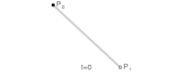
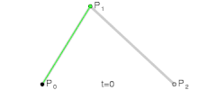
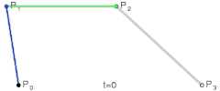
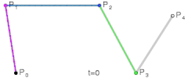
Types of Bezier curves
Linear Bezier curves – It has P0 and P1 points. Basically, it refers to a line.
Quadratic Bezier curves – It has 3 control points, P0, P1 and P2.
Cubic Bezier curves – It has 4 control points, P0, P1, P2 and P3.
Higher-order Bezier curves.
https://en.wikipedia.org/wiki/B%C3%A9zier_curve

Slide 31
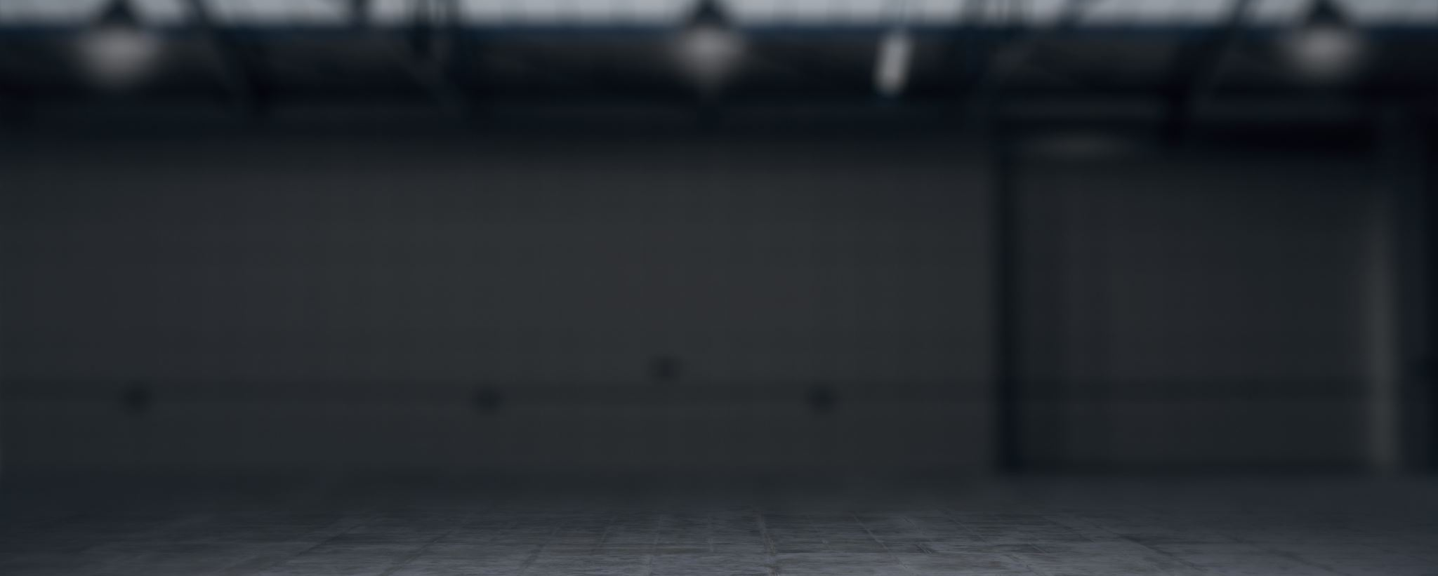
Demo – Bezier curves
https://math.hws.edu/graphicsbook/c2/s1.html

Slide 32
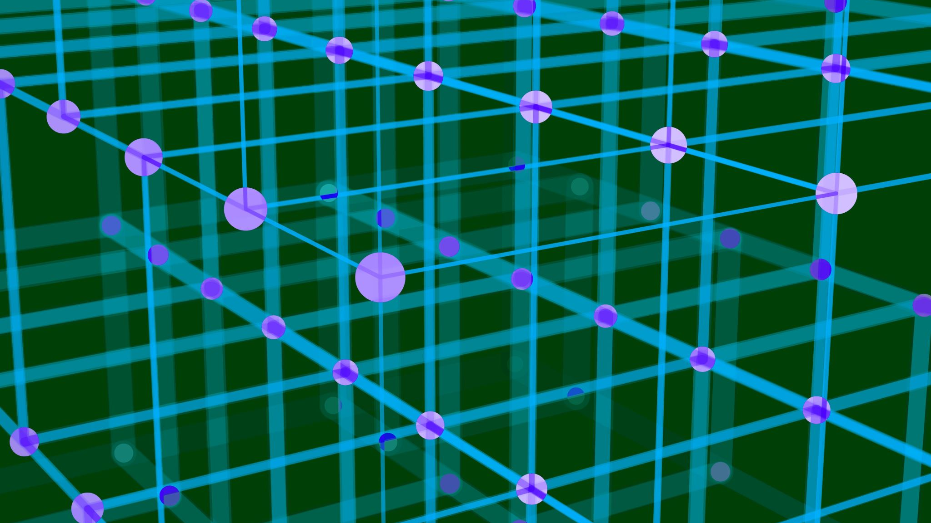
Transformations

Slide 33
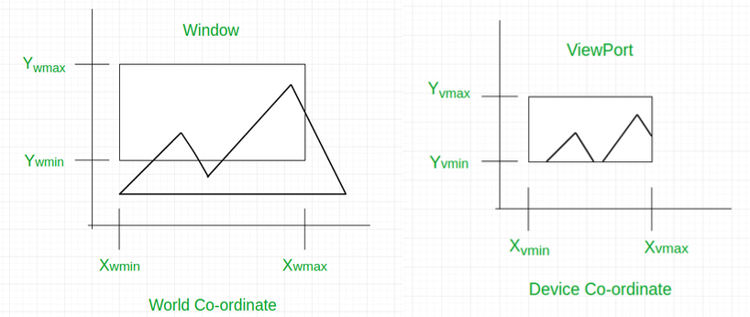
Viewing objects
A viewport in computer graphics and visualization is a rectangular area where the final rendered image or part of the image is displayed. It acts as a window through which a user views the scene, specifying what part of the world space or object space is visible to the viewer.
https://www.geeksforgeeks.org/window-to-viewport-transformation-in-computer-graphics-with-implementation/
Notes:
Imagine you have a large canvas where you're creating a detailed painting (the entire scene). The viewport would be like holding a frame up to the canvas, focusing only on a specific section of the painting to be displayed at a time.

Slide 34
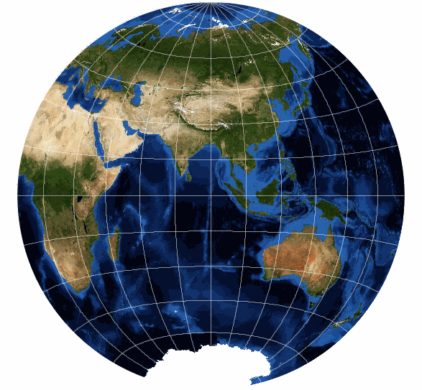
World coordinates
The world coordinate system exists independently of the final viewing perspective. This means objects maintain their positions and orientations in the scene regardless of how the scene is ultimately viewed or displayed on the screen (through the viewport).
World coordinates enable the definition of spatial relationships between objects. For example, placing a tree at a specific location relative to a house within a virtual environment.
Transformations
Lighting
Physics
User inputs
World coordinates are a fundamental concept in computer graphics, referring to a coordinate system in which objects and scenes are defined.
Our created 2D objects make up a scene. Objects reside on the virtual world. A coordinate system of the virtual world specify where objects are located.

Slide 35
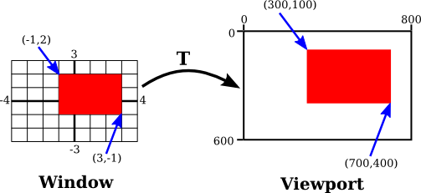
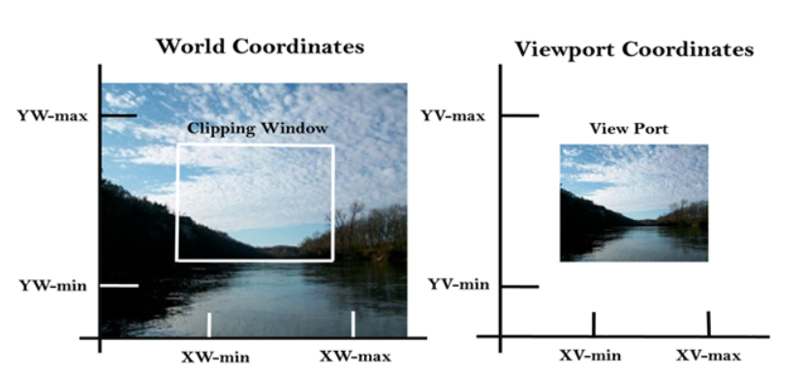
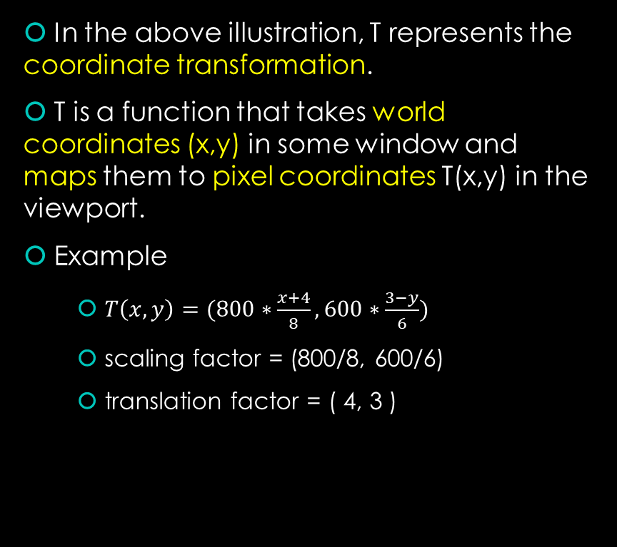
World-Viewport tranformation
In the above illustration, T represents the coordinate transformation.
T is a function that takes world coordinates (x,y) in some window and maps them to pixel coordinates T(x,y) in the viewport.
Example
$T\left(x,y\right)=(800∗\frac{x+4}{8}, 600∗\frac{3−y}{6})$
scaling factor = (800/8, 600/6)
translation factor = ( 4, 3 )
https://www.geeksforgeeks.org/window-to-viewport-transformation-in-computer-graphics-with-implementation/
Notes:
Shift x → 4 blocks
Shift y → 3 blocks
Turn up-side down → -y

Slide 36
Object coordinates (Local coordinates)
Key Characteristics
Relative Positioning
Coordinates are specified relative to the object's own origin. For example, the vertex positions of a model are defined in the object’s own coordinate system.
Independence
This system is independent of the object's position, orientation, and scale in the world space. It only concerns the intrinsic geometry of the object itself.
Convenience for Modelling
Using local coordinates makes it easier to model and manipulate objects without worrying about their position in the broader scene. For instance, a cube might have vertices at positions (1, 1, 1), (-1, 1, 1), etc., in its local coordinate system.
The coordinate system used to define an object's geometry independently of its position in the world

Slide 37
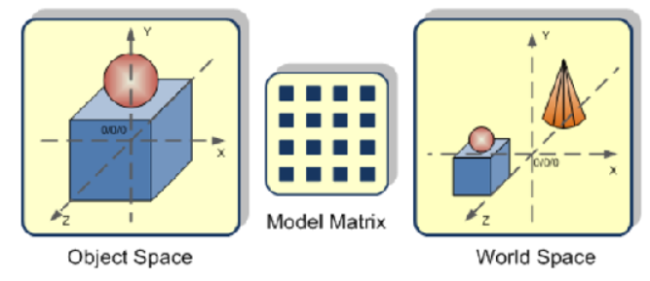
Modelling transformation
Object Coordinates - The coordinate system used to define a single object in a way that's convenient for its creation.
Defining objects in their own coordinate systems (object coordinates) allows for easy reuse and manipulation across different scenes and frames, particularly useful in animations.
World Coordinates - The overall coordinate system encompassing the entire scene, where all objects are ultimately positioned.
By using separate coordinate systems, designers can work flexibly with objects and scenes, making adjustments and transformations without altering the fundamental definitions of the objects.
Modeling Transformation - The transformation applied to move an object defined in its own coordinates (object space) to its final location in the world scene.
Separating world and object coordinates allows for a more natural scene description. We define objects in a way that makes sense for them (object coordinates), and then transform them for final placement in the scene (world coordinates). This is easier than constantly working with viewport limitations.
https://dl.acm.org/doi/10.1145/3134472.3136556

Slide 38
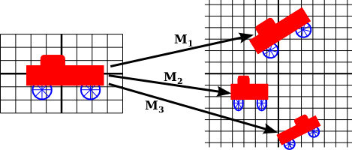
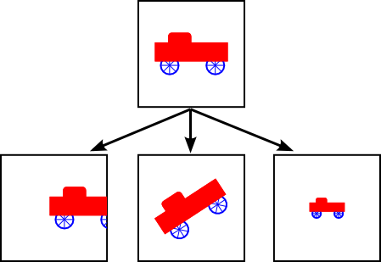
Modelling transform vs Viewport transform
Creating an object defined on its object coordinates allows us to manipulate the object independently with modelling transform.
The object can be reused multiple times and replicated in world coordinates.
What happens when we see an object in the viewport … ?
Modifying the view window effectively changes the coordinate system applied to the viewport.
Changing the view window or moving objects in the scene are equivalent operations, as both result in the same final image when opposite transformations are applied.
Understanding that transforming the view window and transforming objects are interchangeable helps simplify and unify the approach to manipulating scenes and objects in computer graphics.

Slide 39

Demo – Transform
https://math.hws.edu/graphicsbook/c2/s3.html

Slide 40
Affine transformation
An affine transformation is a type of linear mapping method that preserves points, straight lines, and planes. It includes any transformation that can be represented by multiplying a matrix and a vector, followed by the addition of a vector. In the context of graphics and geometry, affine transformations encompass operations such as translation, rotation, scaling, and shearing. These transformations are used extensively in computer graphics, image processing, and other fields requiring spatial manipulation of data.
Properties
Linearity - Affine transformations preserve straight lines. Any straight line before the transformation remains straight after the transformation.
Parallelism - Parallel lines remain parallel after an affine transformation.
Ratios of Distances - The ratio of distances between points lying on a straight line remains constant. However, angles and distances are generally not preserved unless the transformation is isometric (rigid transformation).

Slide 41
Modelling transform – Affine transform
Modeling transforms are a general term for any transformation applied to an object during its creation or scene placement.
They encompass a wider range of manipulations than just affine transformations.
Their goal is to define the object's final position, orientation, and size within the scene.
Examples of modeling transforms include:
Affine transformations - These include translation, rotation, scaling, and shear, as discussed previously. They are the most common type of modeling transform due to their efficiency and preservation of straight lines.
Non-affine transformations - These include more complex manipulations that go beyond affine properties, such as:
Projective transformation
Non-uniform scaling

Slide 42

Matrix representation of the linear transformations
https://people.computing.clemson.edu/~dhouse/courses/401/notes/affines-matrices.pdf

Slide 43
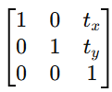
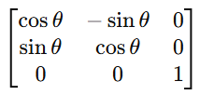
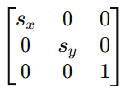
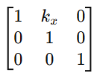
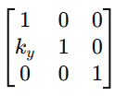
Types of affine transformations
Translation - Moves every point of an object by the same amount in a given direction.
Rotation - Rotates an object about the origin by an angle θ.
Scaling - Enlarges or reduces objects; the scale factor may be different for different axes.
Shearing - Skews the shape of an object along the x-axis or y-axis.
translation
rotation
scaling
shear along x-axis
shear along y-axis

Slide 44
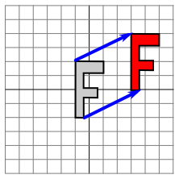
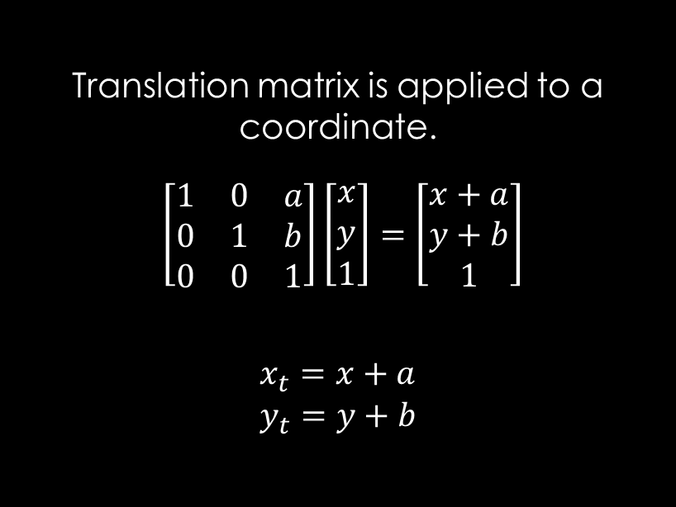
Translation matrix
Translation matrix is applied to a coordinate.
$\left[\begin{matrix}1 & 0 & a \\ 0 & 1 & b \\ 0 & 0 & 1\end{matrix}\right]\left[\begin{matrix}x \\ y \\ 1\end{matrix}\right]=\left[\begin{matrix}x+a \\ y+b \\ 1\end{matrix}\right]$
$$\begin{matrix}x_{t}=x+a \\ y_{t}=y+b\end{matrix}$$

Slide 45
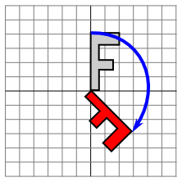
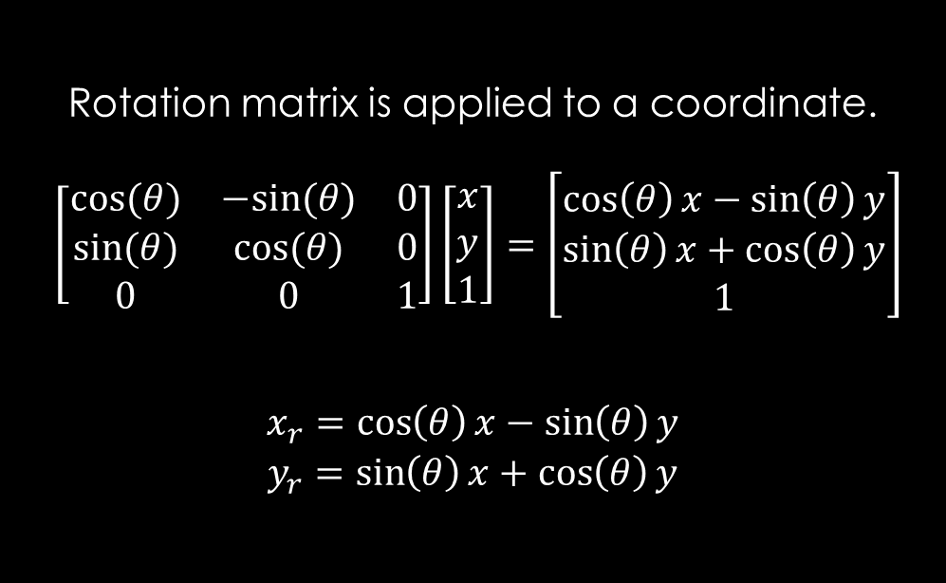
Rotation matrix
Rotation matrix is applied to a coordinate.
$\left[\begin{matrix}cos⁡(θ) & −sin⁡(θ) & 0 \\ sin⁡(θ) & cos⁡(θ) & 0 \\ 0 & 0 & 1\end{matrix}\right]\left[\begin{matrix}x \\ y \\ 1\end{matrix}\right]=\left[\begin{matrix}\cos\left(θ\right)x−\sin\left(θ\right)y \\ \sin\left(θ\right)x+\cos\left(θ\right)y \\ 1\end{matrix}\right]$
$$\begin{matrix}x_{r}=\cos\left(θ\right)x−\sin\left(θ\right)y \\ y_{r}=\sin\left(θ\right)x+\cos\left(θ\right)y\end{matrix}$$

Slide 46
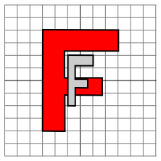
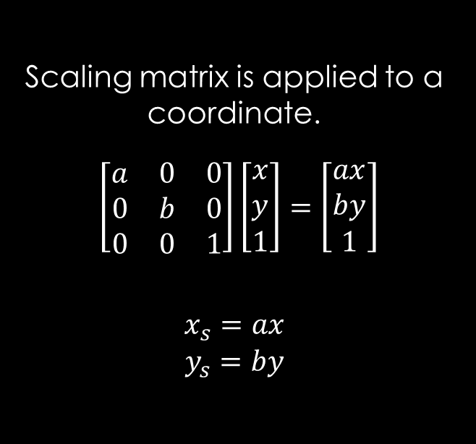
Scaling matrix
Scaling matrix is applied to a coordinate.
$\left[\begin{matrix}a & 0 & 0 \\ 0 & b & 0 \\ 0 & 0 & 1\end{matrix}\right]\left[\begin{matrix}x \\ y \\ 1\end{matrix}\right]=\left[\begin{matrix}ax \\ by \\ 1\end{matrix}\right]$
$$\begin{matrix}x_{s}=ax \\ y_{s}=by\end{matrix}$$

Slide 47

Transformation ordering

Slide 48
Demo – Affine Transform
https://math.hws.edu/graphicsbook/c2/s3.html

